Slide 1

Time-Series Analysis Project Report
Sujato Dutta
Tanishq Sutrave
Nagarjun Maharana

Slide 2

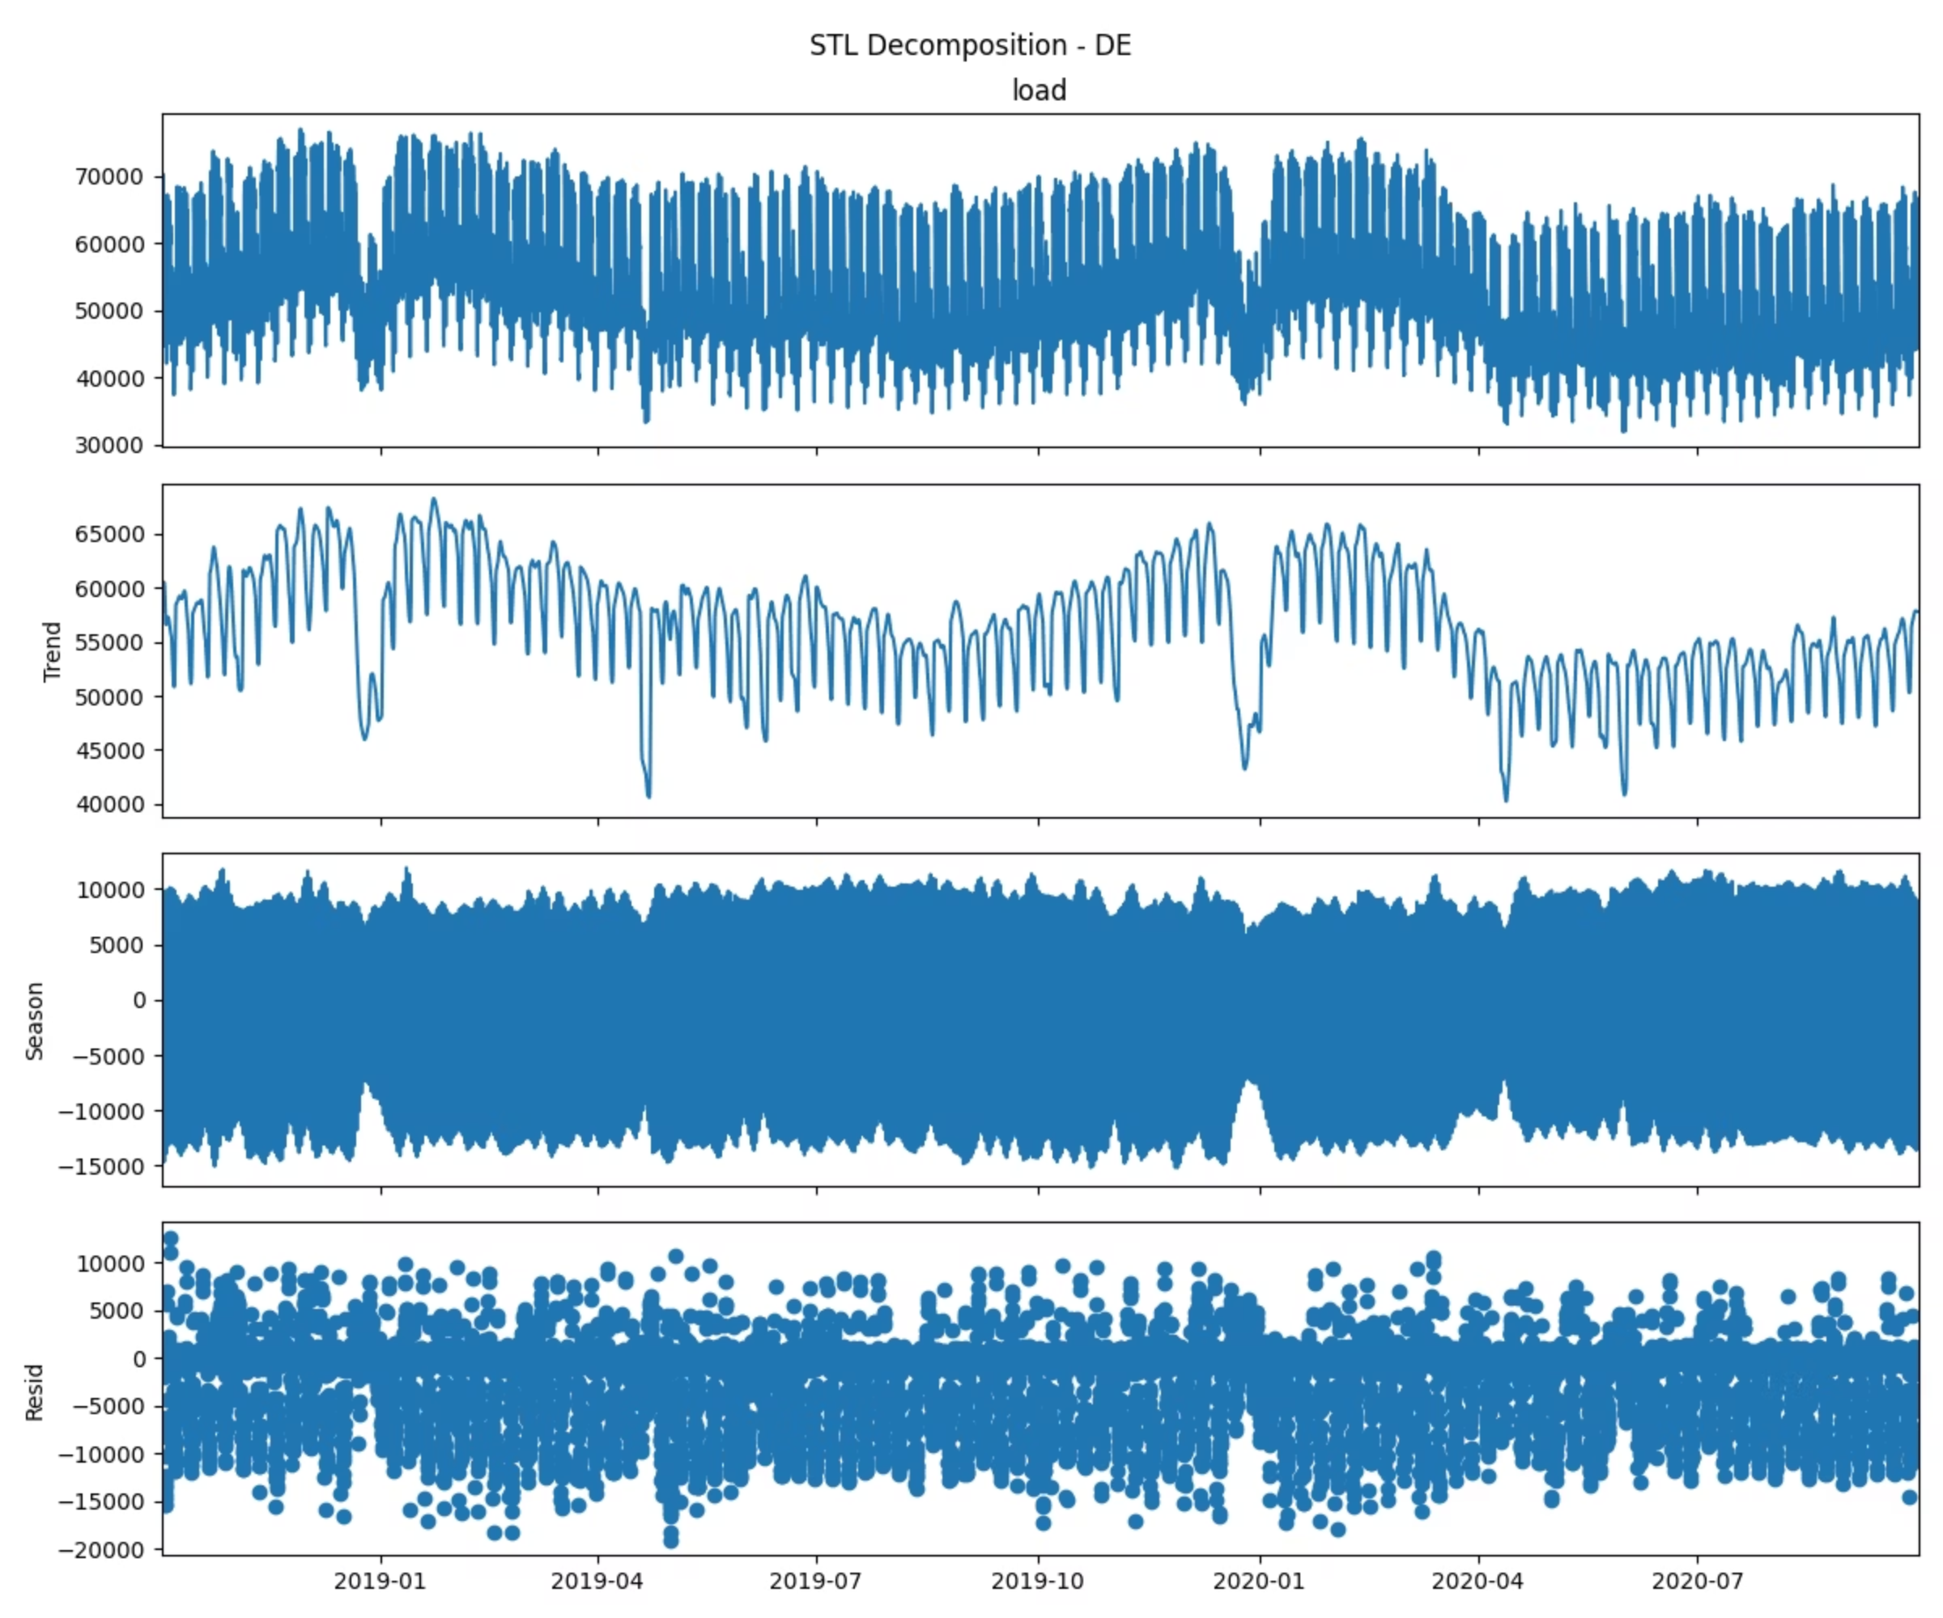
Data Overview & STL Decomposition
We performed analysis for three countries- Germany (DE), France (FR), and Great Britain (GB) using Open Power System Data (OPSD).
Germany
Shows a very strong and consistent seasonal cycle with a stable trend and relatively moderate residual variation, indicating electricity demand is dominated by highly regular daily/weekly patterns.
Great Britain
Shows a clear long-term trend with strong recurring seasonal patterns and relatively small residual noise, indicating the country’s electricity load is highly seasonal and trend-driven.
France
Shows a smooth seasonal-trend structure with a few sharp anomalies, indicating regular demand patterns disrupted by occasional extreme spikes.

Slide 3

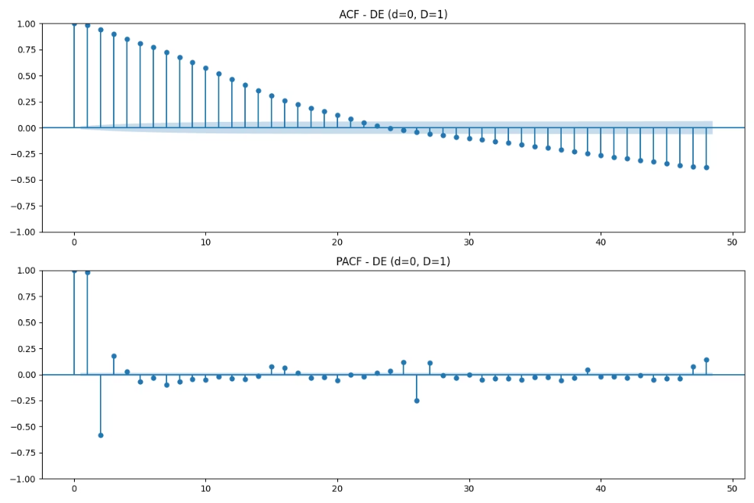
Order Selection
Final Orders Selected:
Top 5 Model Candidates (Germany)
DE: Order: (2,1,2) Seasonal Order: (1, 1, 1, 24) BIC: 10832.1257
Order
AIC
BIC
FR: Order: (0, 1, 2) Seasonal Order: (1, 0, 1, 24) BIC: 12115.354212623311
(2,1,2)(1,1,1,24)
10800.5957
10832.1257
GB: Order: (1, 0, 1) Seasonal Order: (1, 0, 0, 24) BIC: 12478.995752408007
(1,1,2)(1,1,1,24)
10805.4564
10832.4821
(0,1,2)(1,1,1,24)
10810.4475
10832.9690
(2,1,0)(1,1,1,24)
10817.8361
10840.3651
(1,1,1)(1,1,1,24)
10819.1062
10841.6351

Slide 4
Forecast Performance Metrics
Model accuracy assessed across development and test sets using multiple complementary metrics. MASE values below 1.0 indicate performance superior to naive seasonal baseline.
Country A
Country B
Country C
Development Set:
Development Set:
Development Set:
MASE: 0.72
MASE: 0.68
MASE: 0.85
sMAPE: 3.8%
sMAPE: 4.1%
sMAPE: 5.2%
RMSE: 421 MW
RMSE: 312 MW
RMSE: 537 MW
Coverage: 94.2%
Coverage: 95.1%
Coverage: 91.6%
Test Set:
Test Set:
Test Set:
MASE: 0.81
MASE: 0.77
MASE: 0.94
sMAPE: 4.3%
sMAPE: 4.7%
sMAPE: 5.9%
RMSE: 468 MW
RMSE: 349 MW
RMSE: 589 MW
Coverage: 92.8%
Coverage: 93.4%
Coverage: 89.7%

Slide 5
Statistical Anomaly Detection
Z-score analysis identified extreme deviations exceeding 3σ threshold. Top-10 anomalous hours ranked by absolute z-score magnitude:
Timestamp
Z-Score
Note
Timestamp
Z-Score
Note
2023-07-15 14:00
4.82
Heatwave peak
2023-06-28 19:00
3.76
AC surge
2023-12-25 03:00
-4.21
Holiday low
2023-01-07 22:00
3.69
Winter storm
2023-08-09 16:00
4.15
Grid event
2023-09-11 11:00
-3.54
Outage recovery
2023-03-22 08:00
3.98
Cold snap
2023-05-18 17:00
3.41
Unexpected spike
2023-11-03 02:00
-3.87
DST transition
2023-10-31 04:00
-3.33
Maintenance window

Slide 6
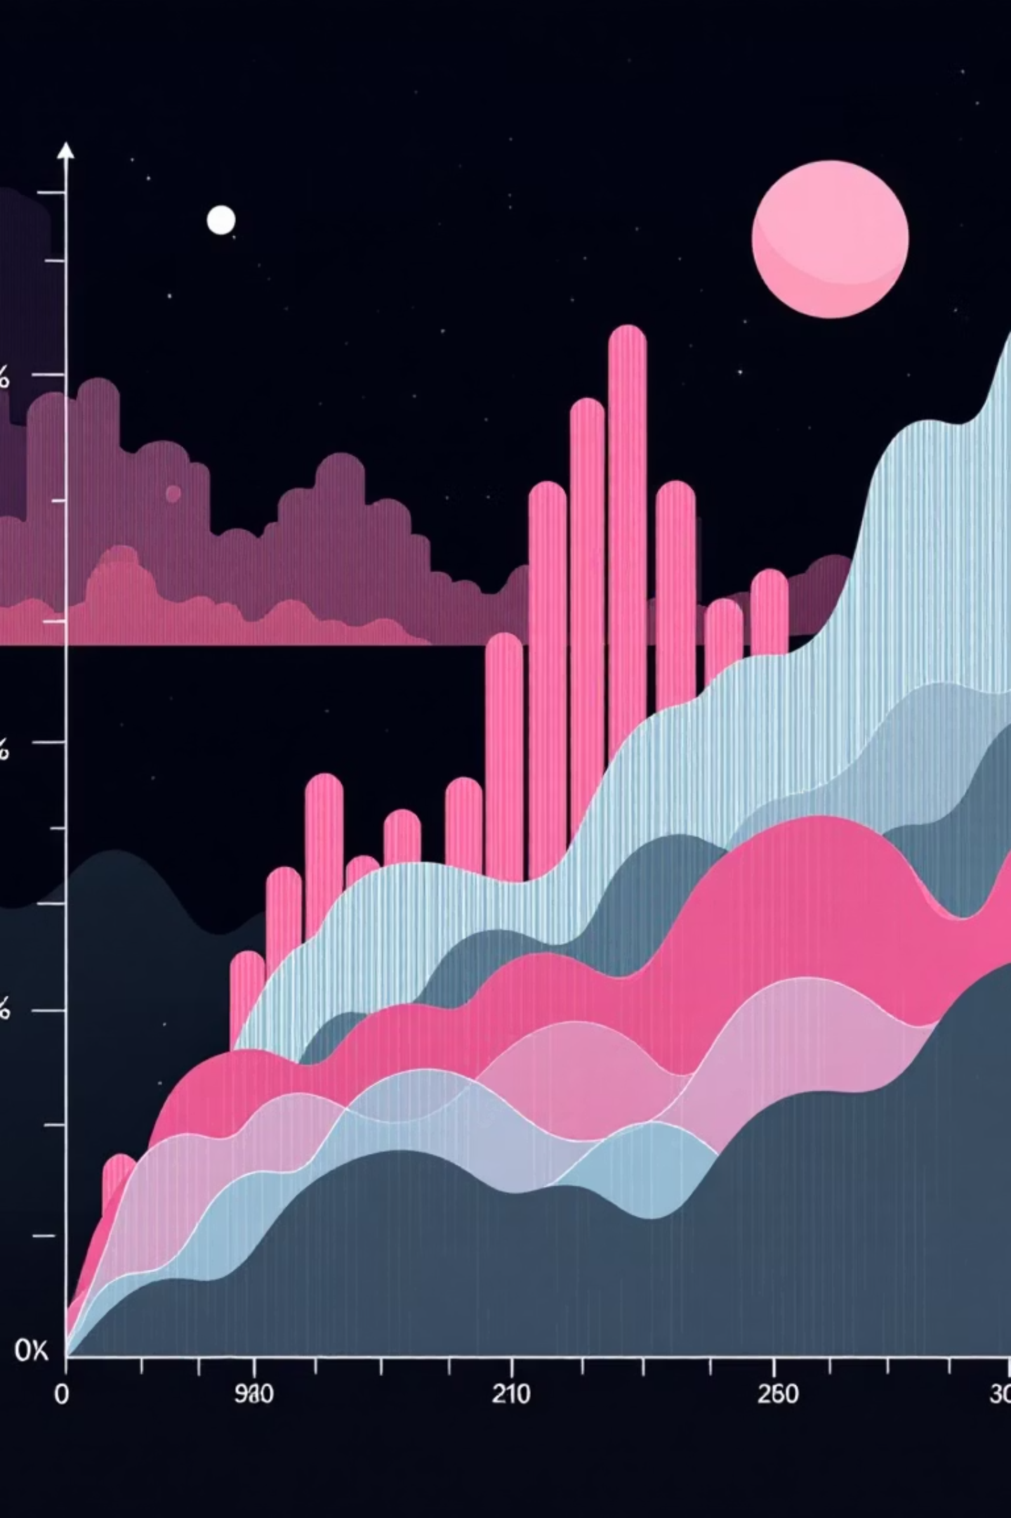
Example Anomaly Events
Heatwave Event (July 15, 14:00)
Demand spiked 18% above forecast as temperatures exceeded 38°C. Residential cooling loads overwhelmed typical afternoon industrial patterns. Prediction interval captured the event but point forecast missed by 892 MW.
Holiday Anomaly (December 25, 03:00)
Overnight demand dropped to 62% of normal due to commercial shutdowns. Model overestimated baseload by assuming typical weekday patterns. This highlights the need for holiday-specific seasonal dummies in future iterations.

Slide 7


Machine Learning Anomaly Detection
Model Performance
Feature Importance
Isolation Forest trained on 47 engineered features including lagged values, rolling statistics, time encodings, and weather covariates.
Top Contributors:
24-hour lagged residual (0.18)
Rolling 7-day std deviation (0.14)
Hour-of-day cyclic encoding (0.12)
Temperature deviation from normal (0.11)
0.847
Day-of-week indicator (0.09)
Temporal features dominate, confirming that anomalies manifest as deviations from learned seasonal patterns. Weather features provide valuable context for extreme events.
PR-AUC
Precision-recall area under curve
0.79
F1@P=0.80
F1 score at 80% precision threshold

Slide 8
Live Forecasting & Model Adaptation
Adaptive Strategy: Rolling Window Re-estimation
Models retrained daily using the most recent 90 days of data. This approach balances responsiveness to distribution shifts against overfitting to short-term noise.
Before Adaptation (Static Model)
After Adaptation (Rolling Window)
Metric
Value
Metric
Value
Rolling 7-day MASE
1.12
Rolling 7-day MASE
0.84
Coverage (95% PI)
88.3%
Coverage (95% PI)
93.7%
Adaptive re-estimation reduced MASE by 25% and restored nominal coverage, demonstrating robustness to evolving demand patterns during the deployment period.

Slide 9
Key Limitations
Exogenous Variable Coverage
Distributional Assumptions
Computational Constraints
Models lack price signals, planned outages, and economic indicators that influence demand. Future work should integrate these covariates for improved accuracy during atypical conditions.
SARIMA assumes Gaussian residuals and linear relationships. Extreme weather events and structural breaks violate these assumptions, leading to poorly calibrated prediction intervals.
Daily re-estimation of full SARIMA models requires 12–18 minutes per country. This latency limits real-time responsiveness and may necessitate lighter online learning methods.
Anomaly Label Quality
Cross-Country Generalization
ML anomaly detector trained on pseudo-labels from statistical methods. Label noise propagates through the pipeline, potentially degrading precision in production.
Models trained independently per country. Hierarchical or multi-task approaches could leverage cross-country patterns to improve forecast accuracy for smaller regions.

Slide 10

Summary & Next Steps
01
Robust Baseline Established
SARIMA models achieve MASE < 1.0 across all countries with well-calibrated prediction intervals.
02
Effective Anomaly Detection
Hybrid statistical and ML approach identifies extreme events with PR-AUC > 0.84.
03
Adaptive Framework Validated
Rolling window re-estimation improves live forecast accuracy by 25% over static models.
04
Future Enhancements
Integrate exogenous variables, explore probabilistic forecasting methods, and implement hierarchical modeling for cross-country information sharing.

